Slide 1
IBM University Engagement Project Submission
“Exploring the Power of Agentic AI with IBM Granite and IBM Bob”

Slide 2

Project Tile – The AI Mechanical Safety Compliance Advisor
Domain of Project – Industrial Safety
Student Name | Recent Passport Photo | Email ID | Mobile number [WhatsApp]
SONU RATHA |  | sonuratha891@gmail.com | 7849094910

Slide 3
Problem Statement No.35 - The AI Mechanical Safety Compliance Advisor
The Challenge
Industrial machines must comply with strict safety regulations and operational standards. Monitoring compliance across large industrial facilities can be difficult, and violations may lead to safety hazards, accidents, and regulatory penalties. Organizations require intelligent systems that can continuously monitor operations and highlight potential safety risks.
The Objective
Build an AI-powered Mechanical Safety Compliance Advisor that analyzes machine operations and safety regulations to detect compliance risks.
Safety Data Retrieval (RAG) :– Collect machine safety standards and operational logs.
Risk Detection :– Identify unsafe operating conditions.
Compliance Verification :– Compare operational parameters with safety standards.
Safety Recommendations :– Suggest corrective actions to ensure safe operation.
Multi-Agent System
Safety Data Agent – Collects safety standards and operational data.
Risk Detection Agent – Identifies hazardous conditions.
Compliance Agent – Verifies adherence to safety regulations.
Safety Recommendation Agent – Suggests corrective safety actions.
Visualization Dashboard
Display safety alerts, compliance reports, and recommended safety improvements.

Slide 4
Proposed Solution -
SAFEGUARD-AI is an AI-powered Industrial Safety Intelligence Platform that continuously analyzes machine telemetry, identifies safety risks, verifies compliance requirements, retrieves supporting safety evidence, and provides actionable recommendations.
Key components
1. Real-Time Machine Monitoring: Collects parameters such as temperature, vibration, RPM, pressure, load, guard and interlock status.
2. AI-Based Risk Detection: Analyzes machine conditions and calculates a risk score and severity level.
3. Safety Compliance Verification: Checks the current machine condition against relevant safety requirements and identifies compliant/non-compliant conditions.
4. RAG-Based Safety Evidence: Retrieves relevant information from the available safety documents to support compliance decisions.
4. Multi-Agent AI: Uses specialized agents for safety data, risk detection, compliance verification, and recommendations.
5. Actionable Recommendations: Generates immediate, corrective, and preventive safety actions.
6. Alert System: Raises alerts when critical or high-risk conditions are detected.
7. Interactive Dashboard: Displays machine status, telemetry, risks, compliance, evidence, recommendations, and alerts.
8. What-If Analysis: Allows users to change machine parameters and evaluate how those changes affect safety risk and compliance.

Slide 5
Technology Used
Python — Core backend and AI logic
FastAPI — Backend REST API
SQLite — Database for machines, telemetry, risks, compliance, and alerts
RAG (Retrieval-Augmented Generation) — Retrieval of relevant safety evidence
TF-IDF — Current local RAG retrieval/indexing
ChromaDB — Vector database/RAG storage
Multi-Agent AI Architecture — Safety Data, Risk Detection, Compliance, and Recommendation agents
IBM Watsonx — AI/LLM integration (optional; rule-based fallback is currently active)
IBM Langflow — Agent/RAG workflow integration (optional/not configured in current local setup)
HTML/CSS/JavaScript / frontend framework — Interactive dashboard
Node.js & npm — Frontend development/build
Git & GitHub — Version control
Machine Simulation — Generates industrial machine telemetry for testing/demo

Slide 6
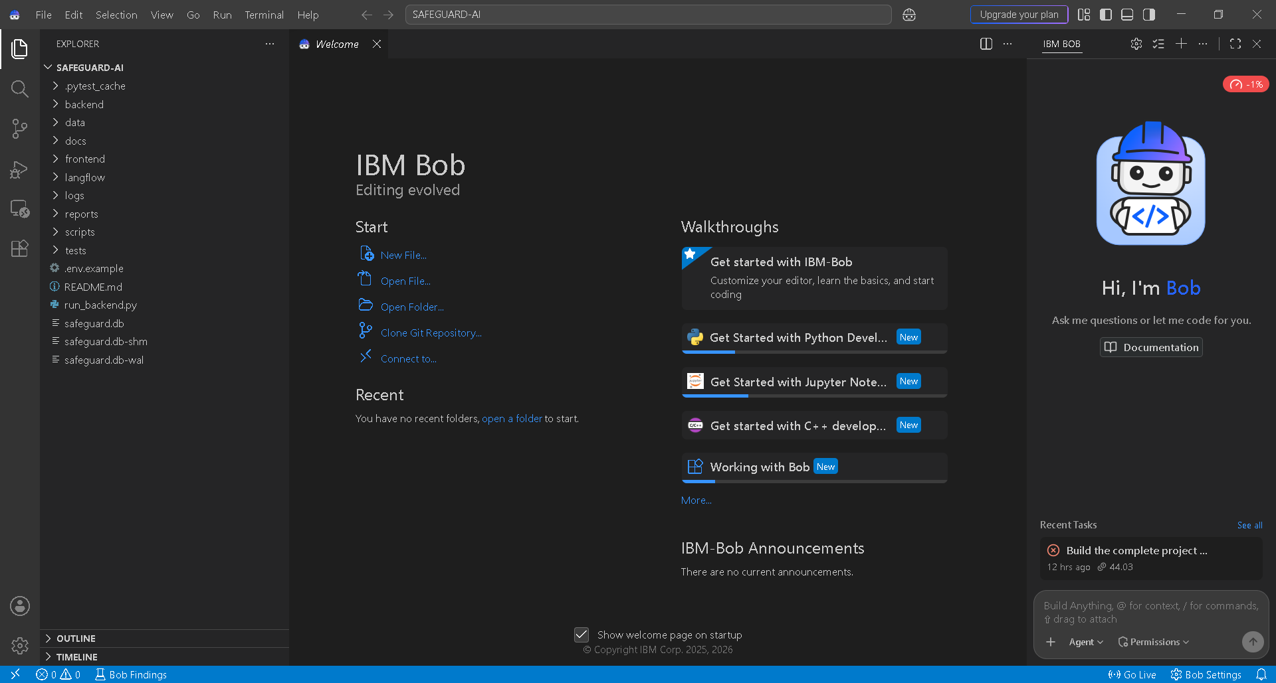
Required Files created using IBM bob -
App.py
Requirements.txt
Style.css
.env
Index.html

Slide 7
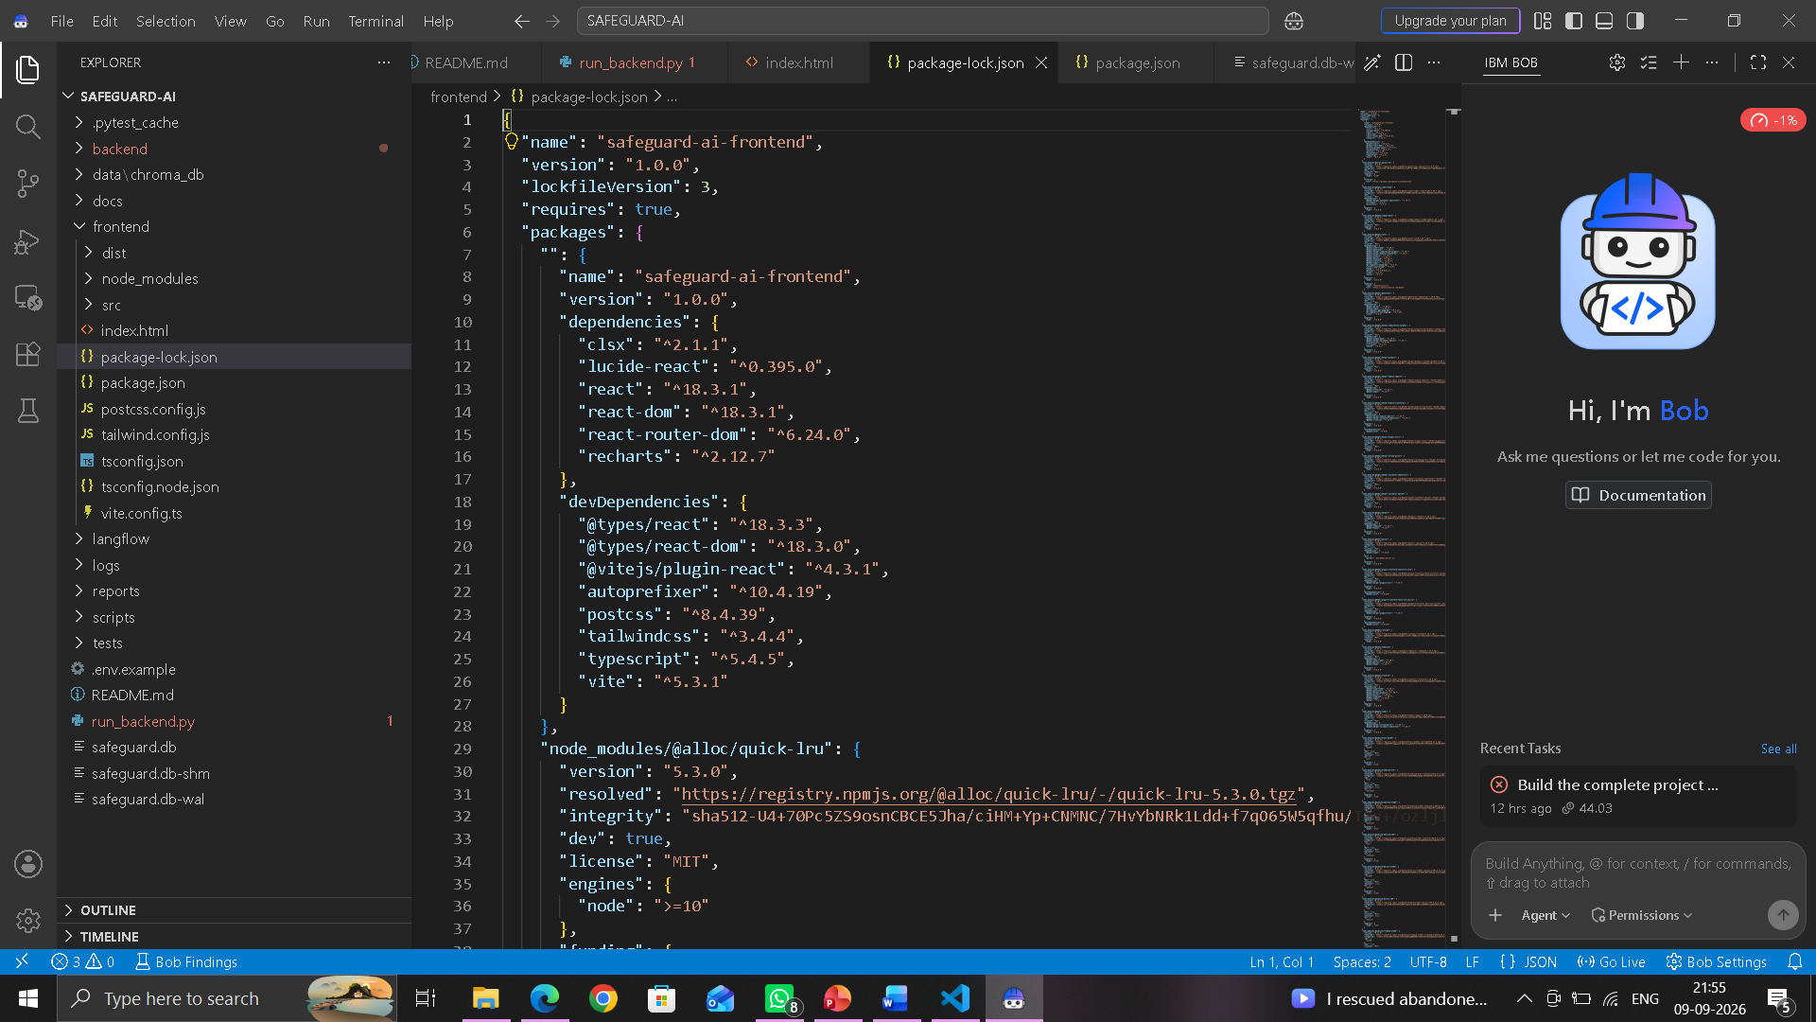
IBM Bob Screenshots:

Slide 8
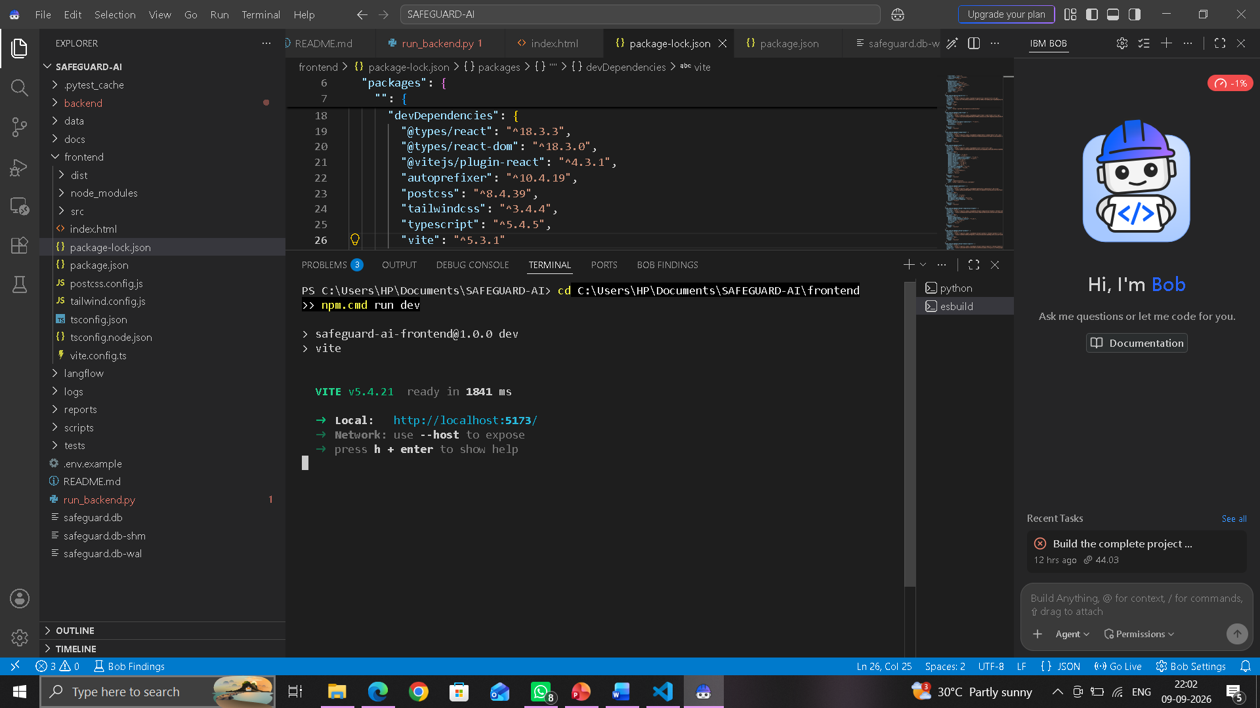

Slide 9
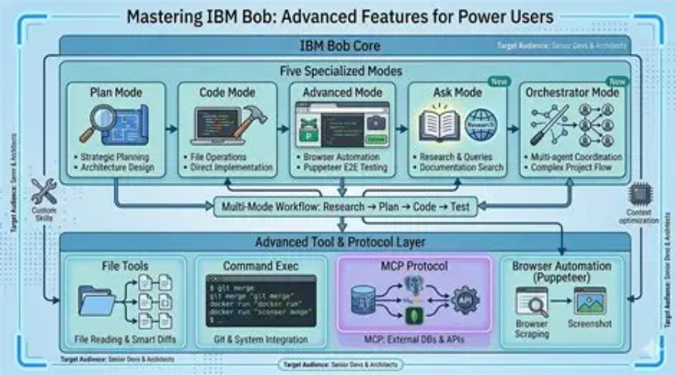
Architecture blueprint for IBM bob:

Slide 10

Role of Agentic AI in the solution
Role of Agentic AI in Nutrition Agent
Agentic AI enables the Nutrition Agent to function as an intelligent, autonomous system rather than a simple chatbot. Using IBM watsonx.ai and IBM Granite models, it coordinates multiple specialized agents to deliver personalized nutrition guidance.
Each agent performs a specific role—such as retrieving nutritional data, generating diet plans, providing health advice, and analyzing food logs—while working collaboratively. This multi-agent approach ensures efficient task execution and accurate results.
Agentic AI also brings context awareness, understanding user details like age, health conditions, and fitness goals to generate tailored recommendations. It supports real-time adaptation, continuously updating suggestions based on user inputs like daily meals.
Additionally, agents communicate with each other, enabling better decision-making and improved outcomes.
Overall, Agentic AI makes the system proactive, personalized, and goal-driven, acting like a smart digital nutritionist that helps users maintain a healthy lifestyle.

Slide 11
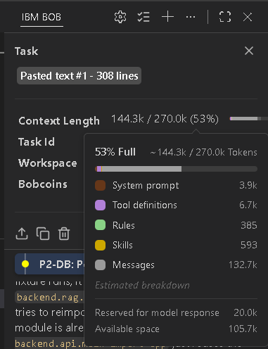
Token Usage
11,761 token are used
After the Prompt
·
·
·

Slide 12
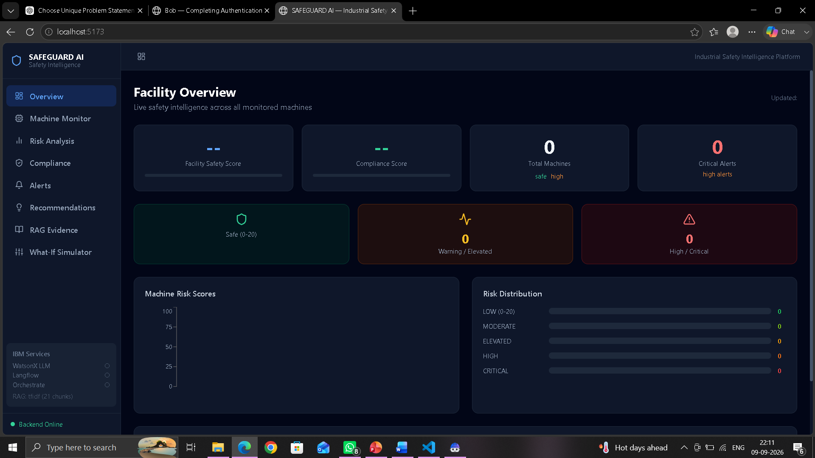
Project Output Screenshot
·
·
·

Slide 13
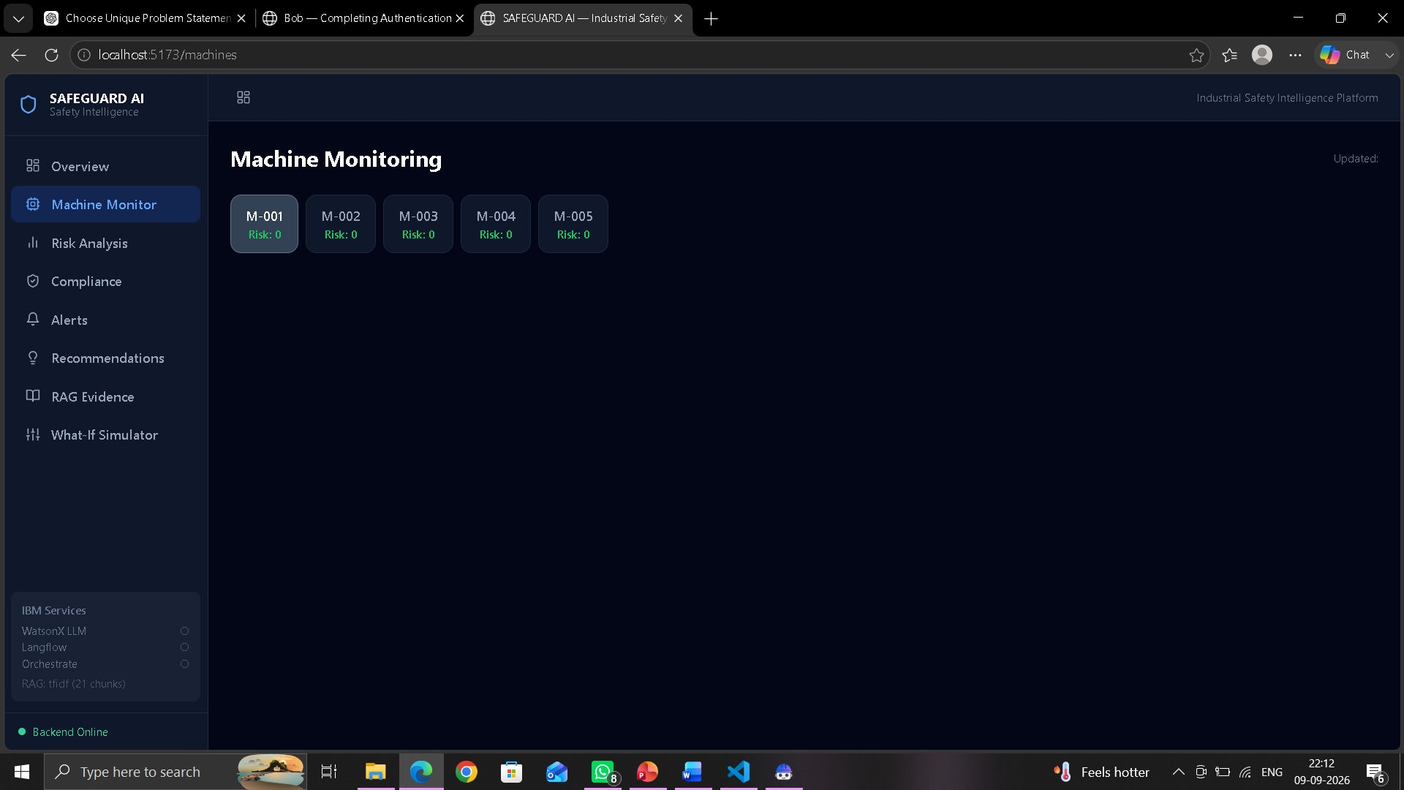
Project Output Screenshot
·
·
·

Slide 14
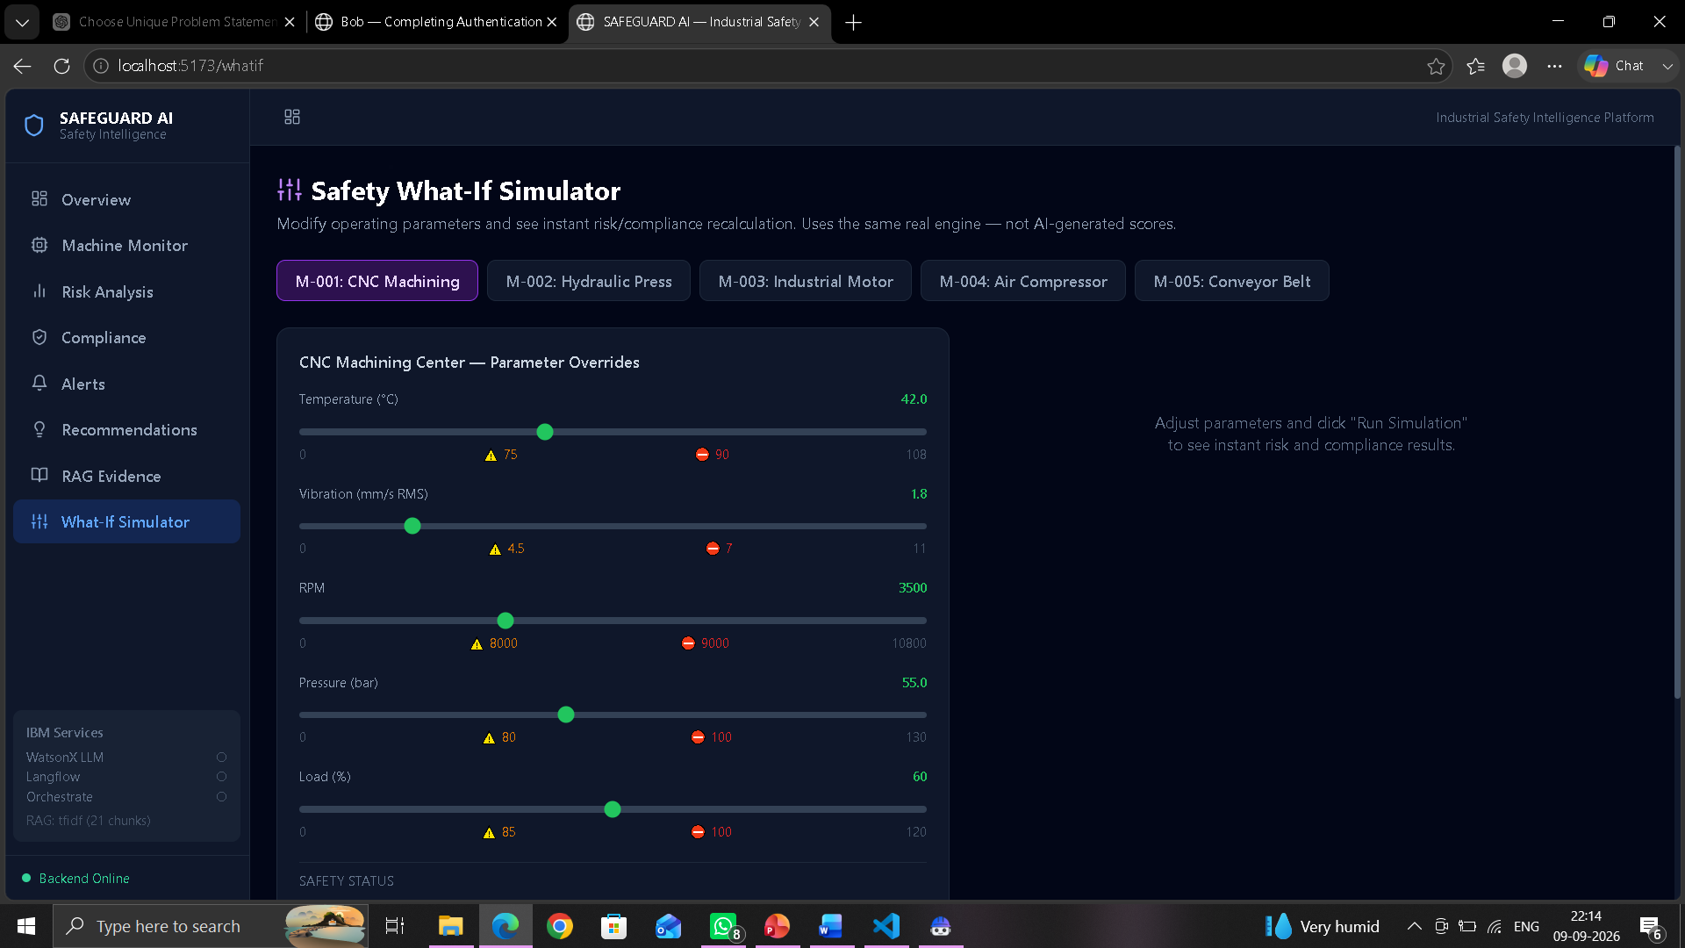
Project Output Screenshot
·
·
·

Slide 15
Novelty and Uniqueness
AI-powered industrial safety advisor that combines machine monitoring with safety compliance.
Multi-agent architecture separates risk detection, compliance verification, and safety recommendations.
RAG-based evidence retrieval provides supporting safety information for compliance decisions.
Real-time risk analysis using machine telemetry such as temperature, vibration, RPM, pressure, and load.
What-If analysis allows users to simulate changing machine conditions and see the resulting safety risk.
End-to-end safety workflow:
Monitor → Detect → Verify → Retrieve Evidence → Recommend → Alert
Interactive dashboard brings machine status, risks, compliance, evidence, and recommendations into one platform.

Slide 16
Git Hub Link
https://github.com/sonuratha31/SAFEGUARD-AI
·
·
·

Slide 17
Future Scope
1. Real-time IoT integration with sensors installed on industrial machines.
2. Advanced AI/ML models for predictive maintenance and early failure detection.
3. Integration with IBM Watsonx and Langflow for more advanced AI-powered reasoning.
4. Support for more industrial safety standards and regulations from different countries.
5. Cloud deployment for remote monitoring of multiple factories.
6. Mobile application for instant safety alerts and notifications.
7. Historical data analytics to identify recurring machine safety patterns.
8. Digital Twin integration for realistic machine simulation and risk prediction.
9. Voice-based safety assistant for hands-free interaction on industrial floors.
10. Automated compliance reports for audits and regulatory inspections.
·
·
·

Slide 18
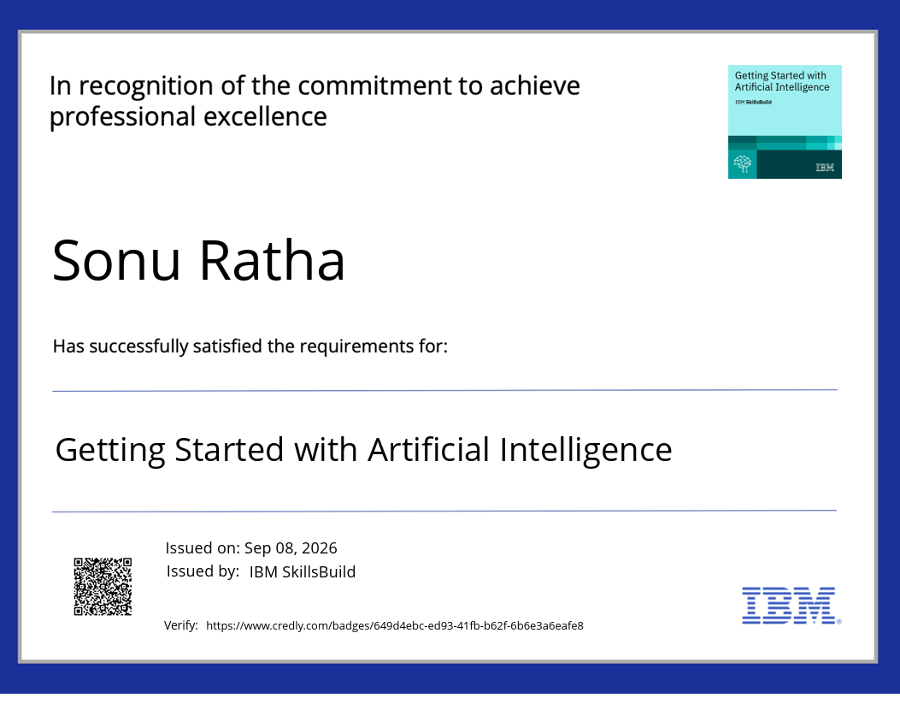
Certificates Earned:

Slide 19
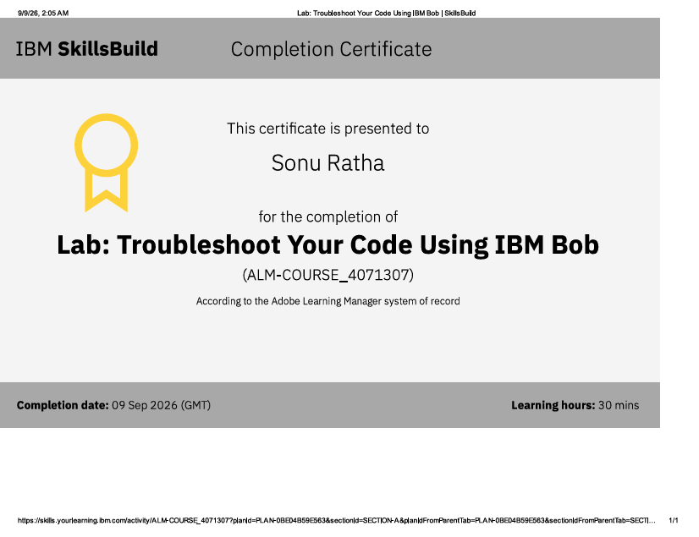
Certificates Earned:​

Slide 20


